Slide 1
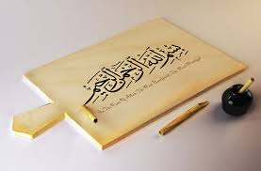

Slide 3
Which shape are you

Slide 4
RESULTS
SQUARE
You’re an organized, logical and hardworking person
RECTANGLE You’re a courageous & slow decision maker
TRIANGLE You’re a born leader who’s competitive & confident
CIRCLE You’re a “people person” with lots of sympathy and consideration for others. You listen and communicate well
SQUIGGLE You’re a creative person who’s always thinking of new ways to do something

Slide 5
Chinese proverb:
If you want to
change the world
change
EDUCATION

Slide 14
ACTIVITY
Think about your teacher
two good
or
two bad thing

Slide 16
What is teacher?
The role of teacher is often formal and on going, carried out at a school or other place of formal education. The focus of teaching is to impart knowledge and information through instruction and explanation.

Slide 17
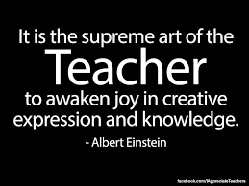

Slide 19
Joke!!!!!!!!!!!!!!!!!!!

Slide 20
Activity
21 QUALITIES OF A
MURABBI

Slide 23
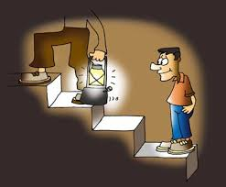
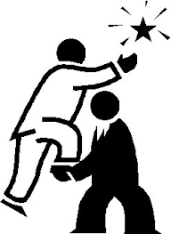

Slide 24
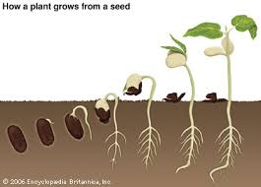
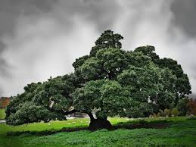

Slide 25
3R’s
*Revolution
*REACTION
* Reforming

Slide 27
Opinion
Attitude
Habits
Values
personality

Slide 28
Who can change
this ?????????

Slide 29
3R’s
*Revolution
*REACTION
* Reforming

Slide 31
MENTOR…………..

Slide 37
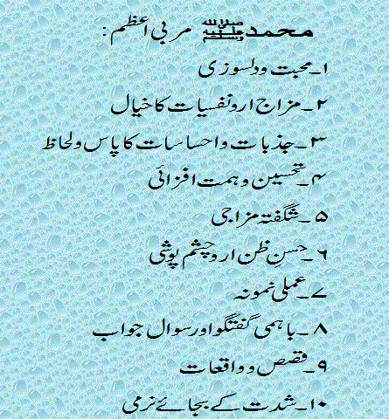

Slide 38
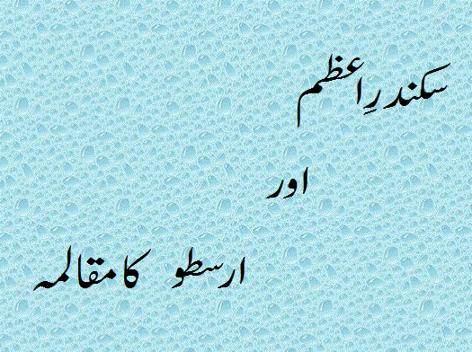

Slide 40
Good Nation Good Teacher
GoodEducation Good People

